Slide 1

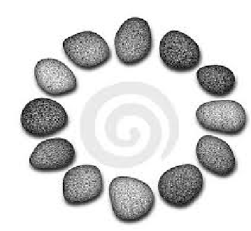







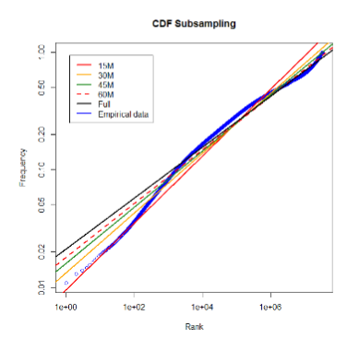

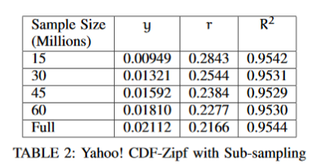





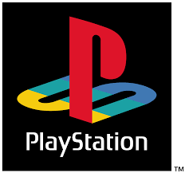
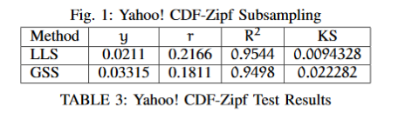
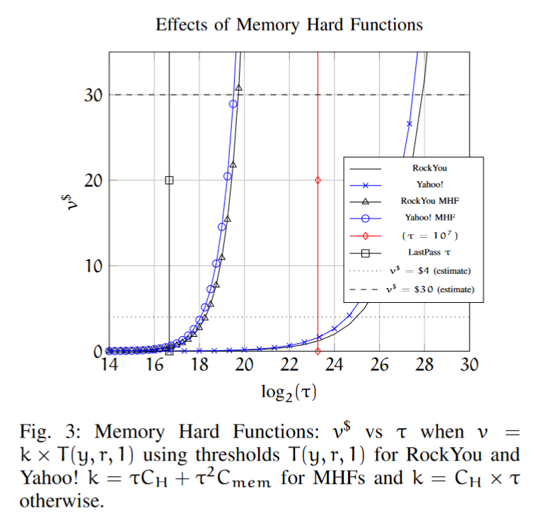
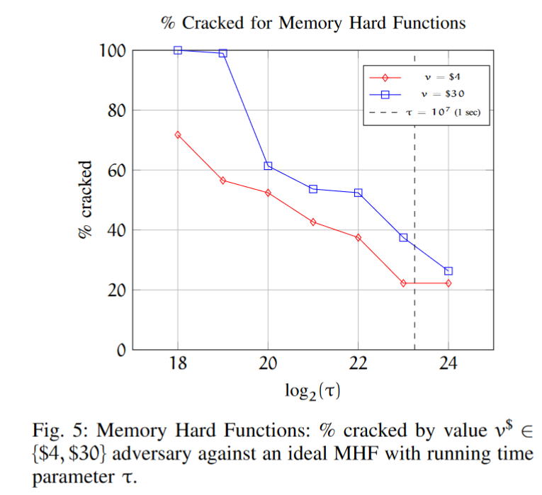
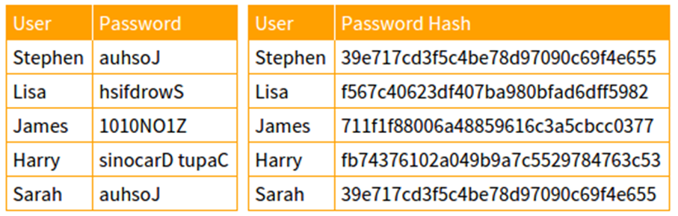




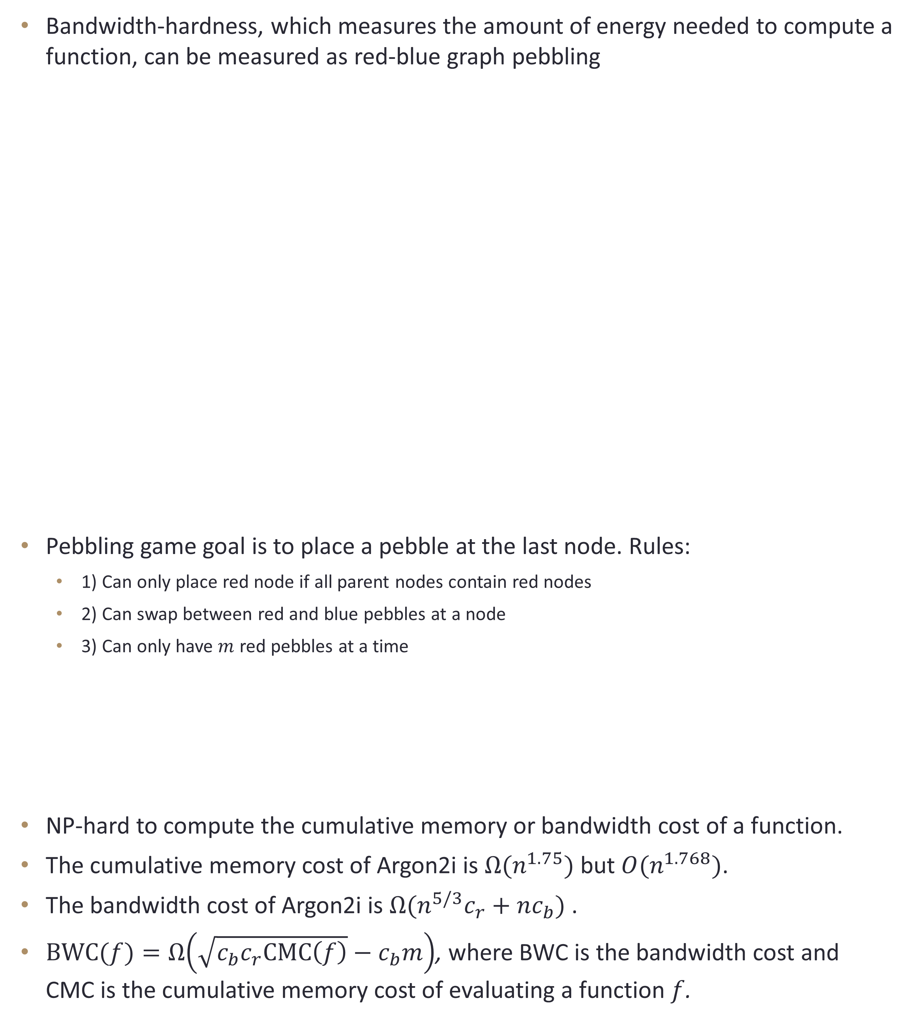


Password Hashing and Graph Pebbling*
Samson Zhou
Department of Computer Science, Purdue University
abstract
methods
results
Although the passwords of users are no longer being stored, we show an offline attacker is compelled to crack all stolen passwords under current security recommendations. Memory hard functions have been proposed as moderately expensive cryptographic tools for password hashing. The cryptanalysis of these functions has focused on the cumulative memory complexity and the energy complexity of the function. The first metric measures how much memory users must commit to evaluating a function, while the second metric measures how much energy users must commit. We prove these evaluations reduce to pebbling games on graphs but show that a tool for exact cryptanalysis of functions is unlikely to exist. Nevertheless, we provide asymptotic upper and lower bounds on several families of functions, including Argon2i, the winner of the password hashing competition that is currently being considered for standardization by the Cryptography Form Research Group of the Internet Research Task Force.
Economics of Password Cracking
Develop a new game theoretic framework to quantify the damage of an offline attack
Show that Yahoo! leaked passwords (over 70 million users) follow Zipfian distribution
Analysis on a Zipfian distribution with estimated black market password costs
Compared key-stretching vs. memory-hard function performance
Model independent analysis, removing the assumption for Zipfian distribution
Models of Function Cost
Formalized the bandwidth cost model
Bandwidth-hard vs Memory-hard
Analysis of Password Hash Functions
Showed NP-Hardness of computing bandwidth cost and cumulative memory cost
Provided upper and lower bounds for cumulative memory cost for several functions
Argon2i, winner of the Password Hashing Competition, is currently being considered for standardization by the Internet Research Task Force (IRTF)
Provided lower bounds for bandwidth cost for several functions
Showed relationship between bandwidth cost and cumulative memory cost. Thus the goals of memory hardness are well-aligned.3
Bandwidth-hardness, which measures the amount of energy needed to compute a function, can be measured as red-blue graph pebbling
Pebbling game goal is to place a pebble at the last node. Rules:
1) Can only place red node if all parent nodes contain red nodes
2) Can swap between red and blue pebbles at a node
3) Can only have $m$ red pebbles at a time
NP-hard to compute the cumulative memory or bandwidth cost of a function.
The cumulative memory cost of Argon2i is $Ω(n^{1.75})$ but $O(n^{1.768})$.
The bandwidth cost of Argon2i is $Ω(n^{5/3}c_{r}+nc_{b})$ .
$BWC(f)=Ω\left(\sqrt{c_{b}c_{r}CMC\left(f\right)}−c_{b}m\right)$, where BWC is the bandwidth cost and CMC is the cumulative memory cost of evaluating a function $f$.
background
Data compromise is inevitable
Recent corporations with leaked passwords:
$$h_{1}=H\left(pwd, salt\right)$$
$$h_{2}=H(h_{1})$$
$$h_{3}=H\left(h_{1},h_{2}\right)$$
$$h_{4}=H(h_{2})$$
$$h_{5}=H\left(h_{3},h_{4}\right)$$
results
pwd
$$h_{1}$$
$$h_{2}$$
$$h_{3}$$
$$h_{5}$$
$$h_{4}$$
objectives
*citations
Assuming password files are leaked, how can we protect against offline attackers?
Make computation of hashes difficult for attackers!
Jeremiah Blocki, Ben Harsha, Samson Zhou. On the Economics of Offline Password Cracking. IEEE Security and Privacy (S&P, Oakland) 2018
Jeremiah Blocki, Ling Ren, Samson Zhou. Bandwidth-Hard Functions: Reductions and Lower Bounds. Manuscript
Jeremiah Blocki, Samson Zhou. On the Computational Complexity of Minimal Cumulative Cost Graph Pebbling. Financial Cryptography and Data Security (FC) 2018
Jeremiah Blocki, Samson Zhou. On the Depth-Robustness and Cumulative Pebbling Cost of Argon2i. 15th IACR Theory of Cryptography Conference (TCC) 2017

